Slide 1
Android Game: Chess
Multiplayer Online Game
Developed by
Md. Mubtashim Abrar Nihal
Roll: 1907010
Section: A
Dept.: CSE

Slide 2
Features
Play chess with others
Watch the leaderboard
Watch others live playing
Review games from game archive
Make friends

Slide 3
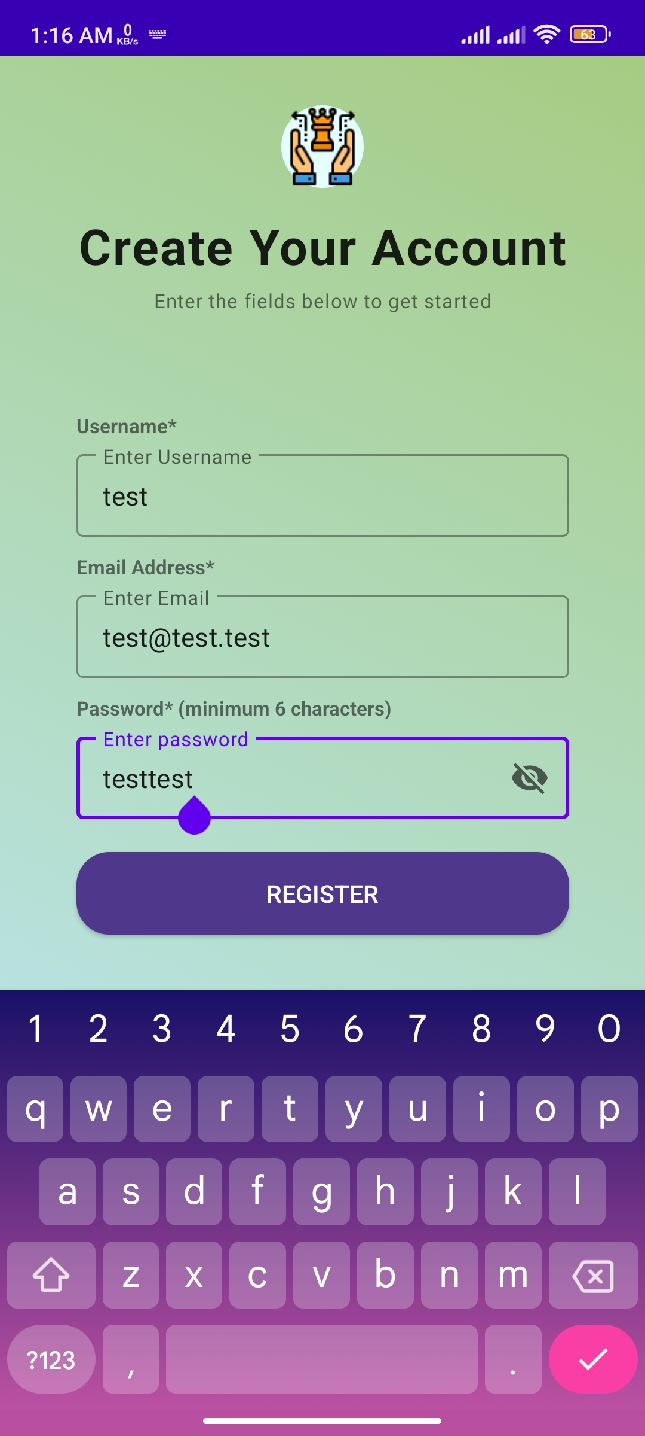
Register : MAIN Page
Register
Username
Email Address
Password

Slide 4
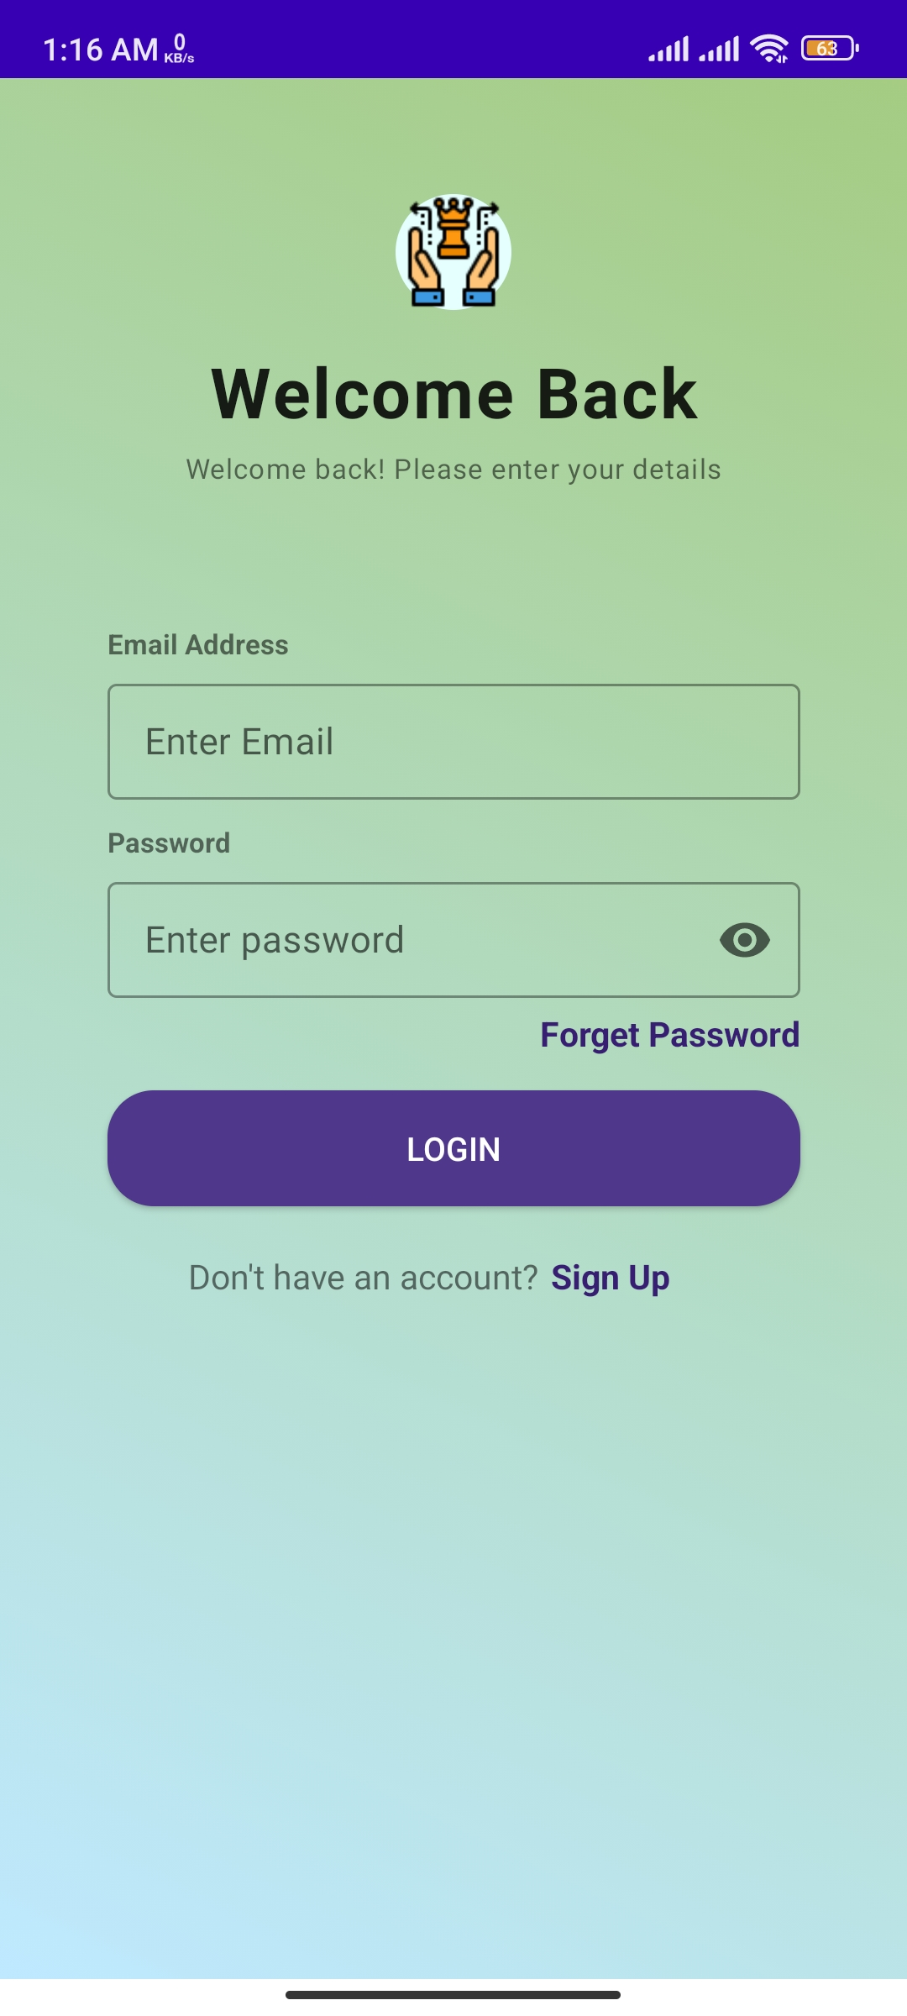
Login: Main page
Login – login to the game
Email
Password
Sign Up – create new account
Forget Password – recover existing account

Slide 5
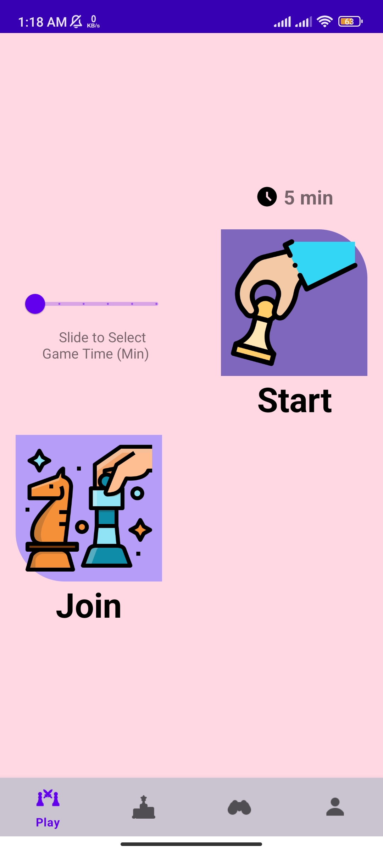
Play : Main page
Start – Start a new game
Duration – how long the game should run
Join – Join in an existing game

Slide 6
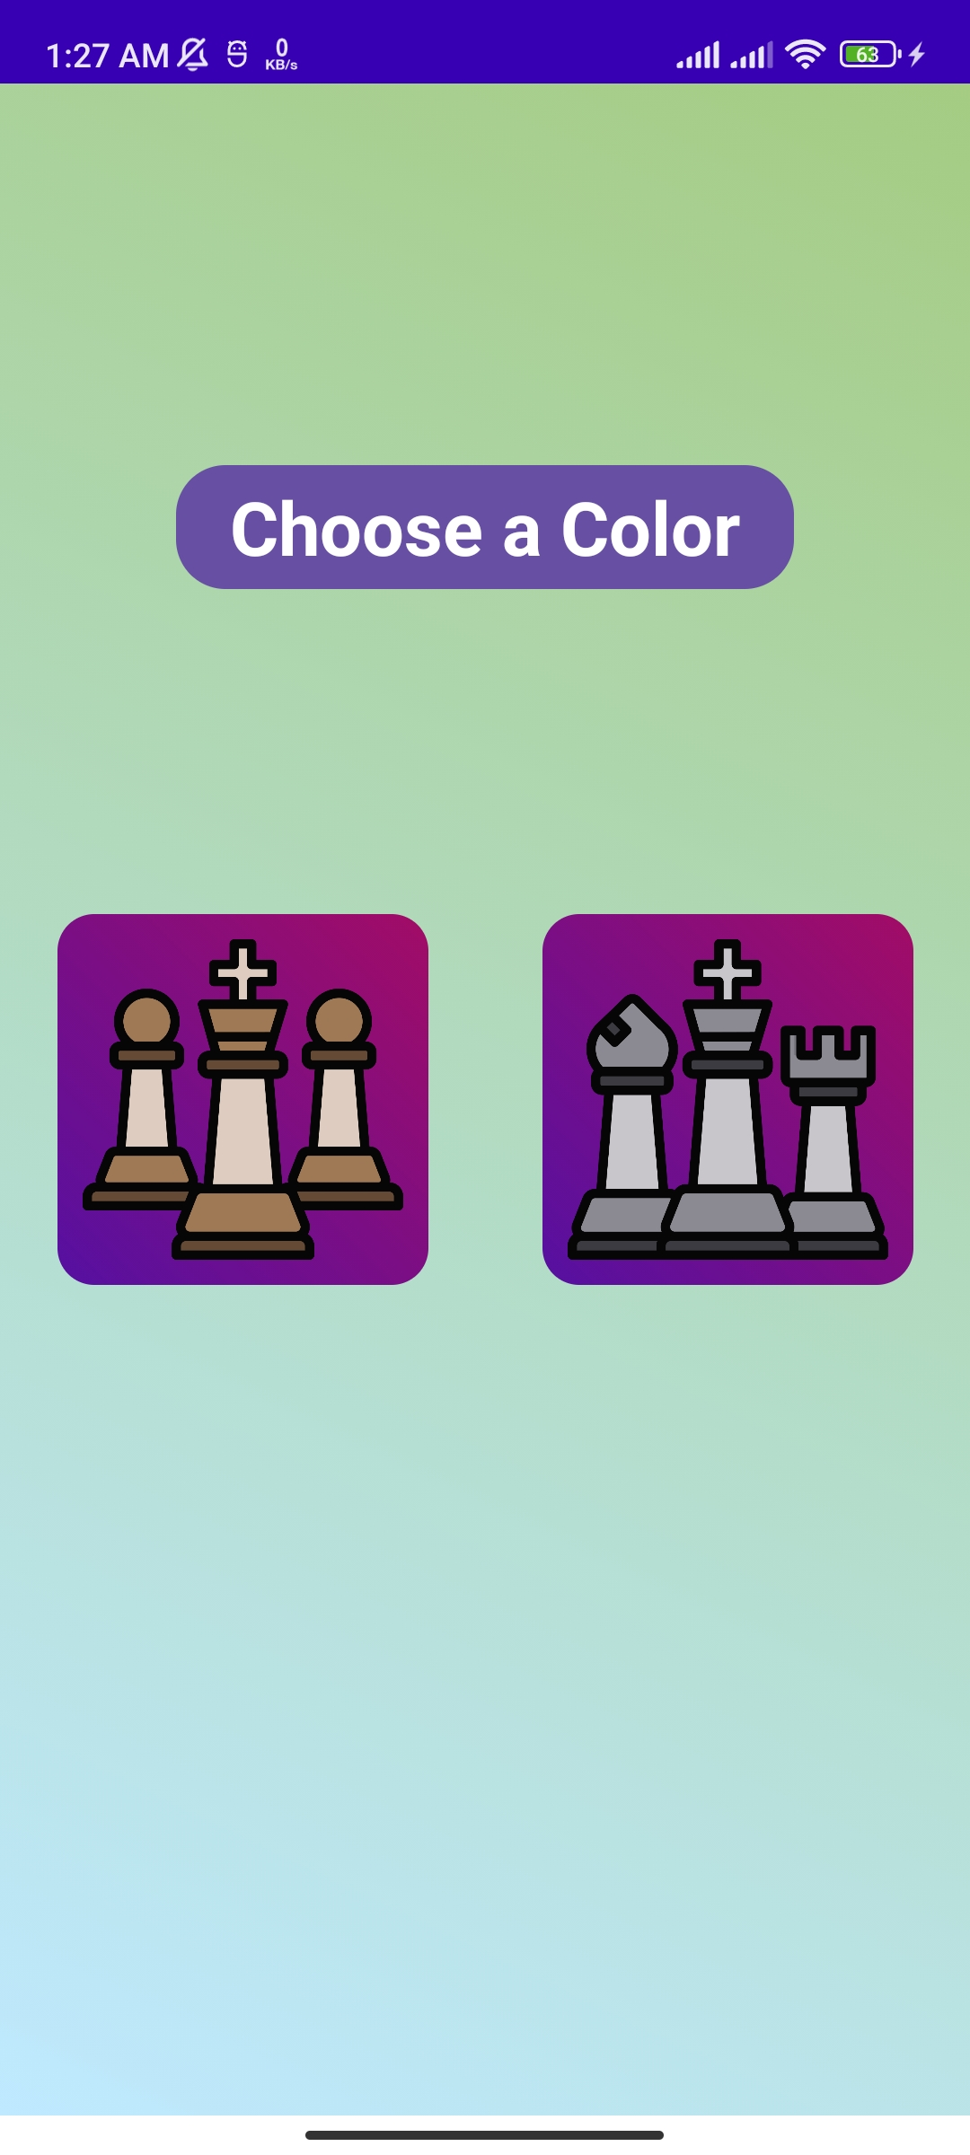
Start game : Choose color
Choose a color – opponent will automatically assigned the remaining color
Options:
White – always performs the first move
Black – performs move after white

Slide 7
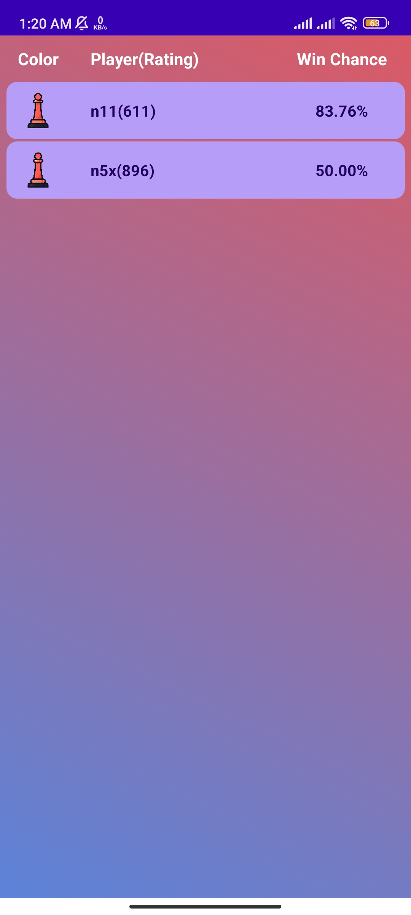
Join game : Main page
A list of currently available games
Color – color you will be played as
Player(Rating) – opponent username with rating
Win chance – the chance of winning the match

Slide 8
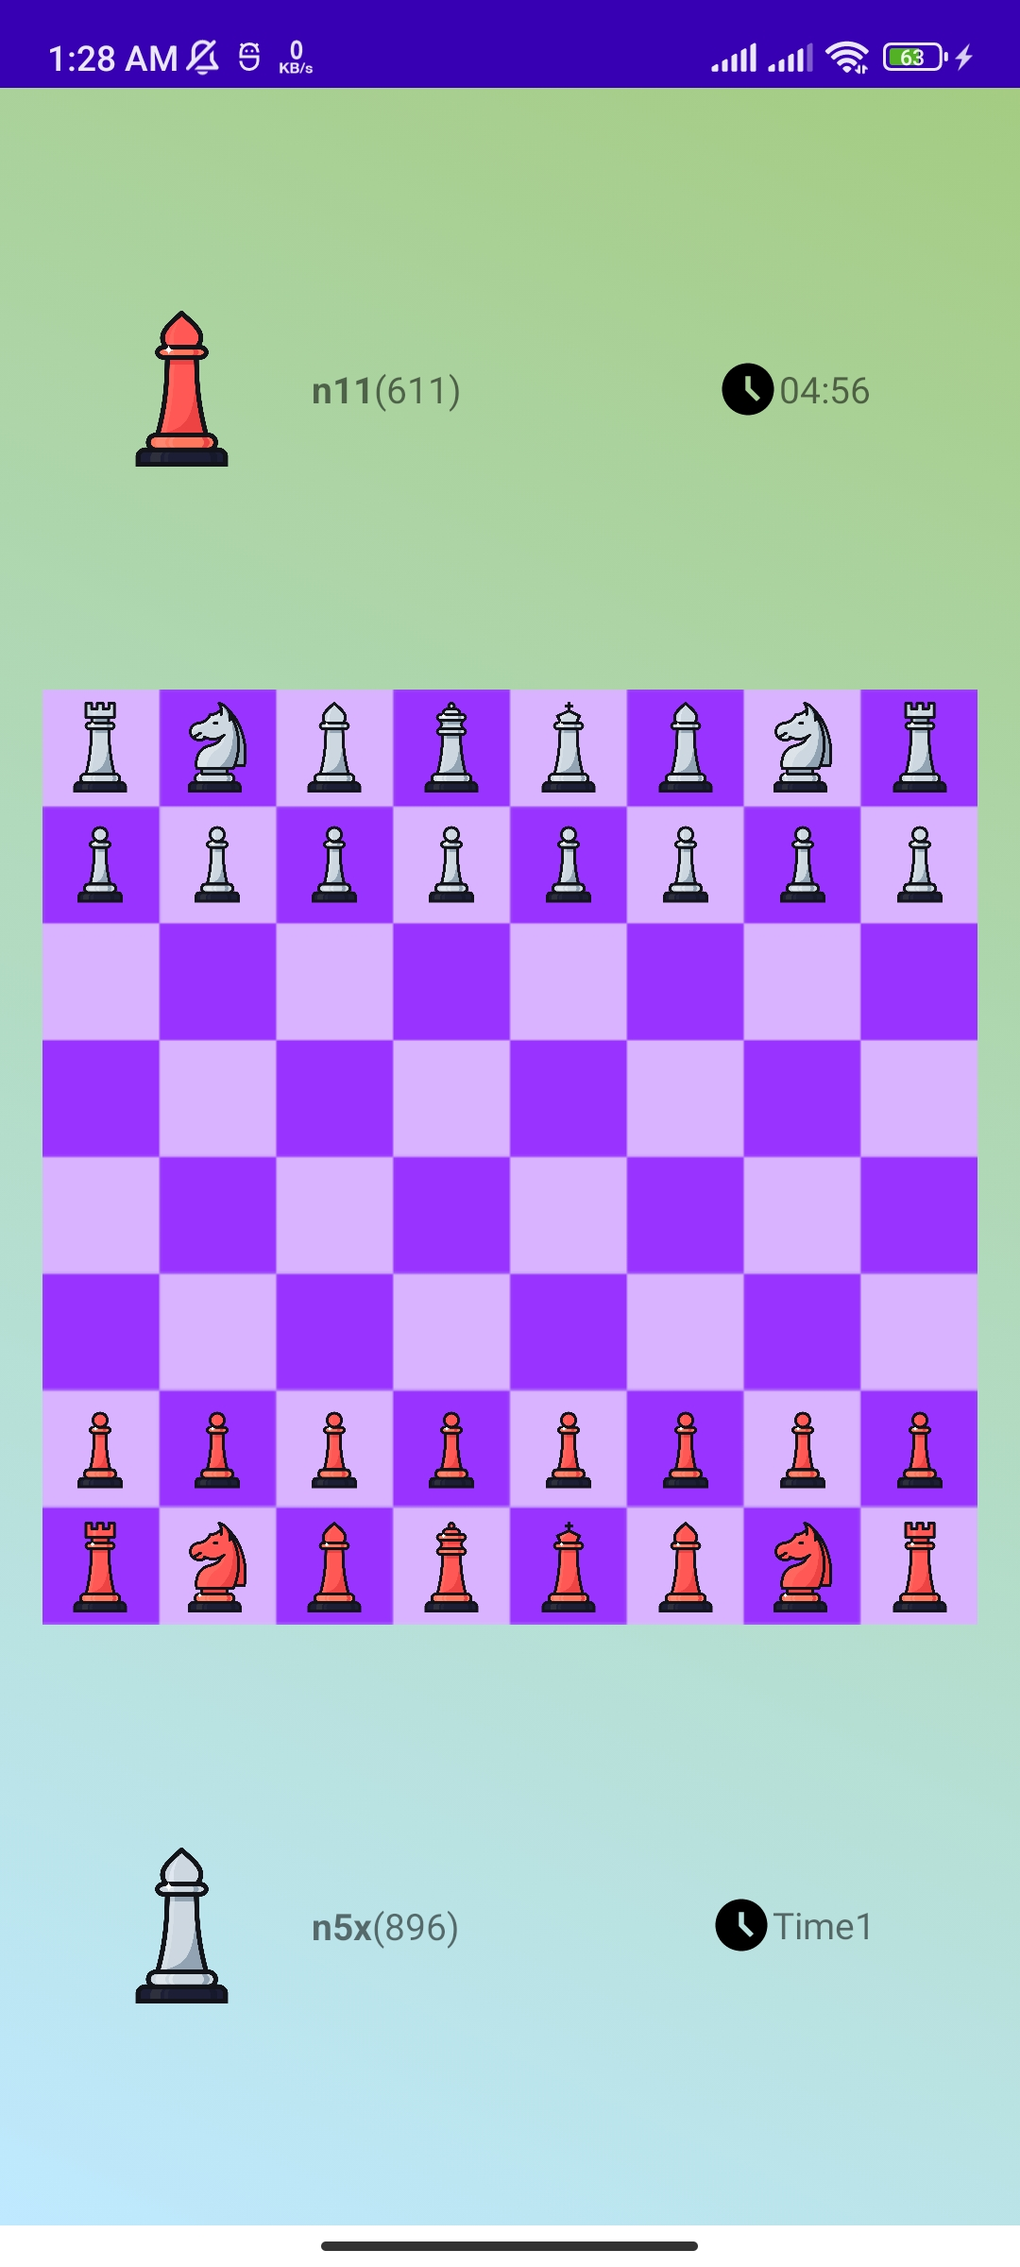
Game: ongoing
Player1
Username, Rating, Remaining time
Player2
Username, Rating, Remaining time
Board – pieces can be moved

Slide 9
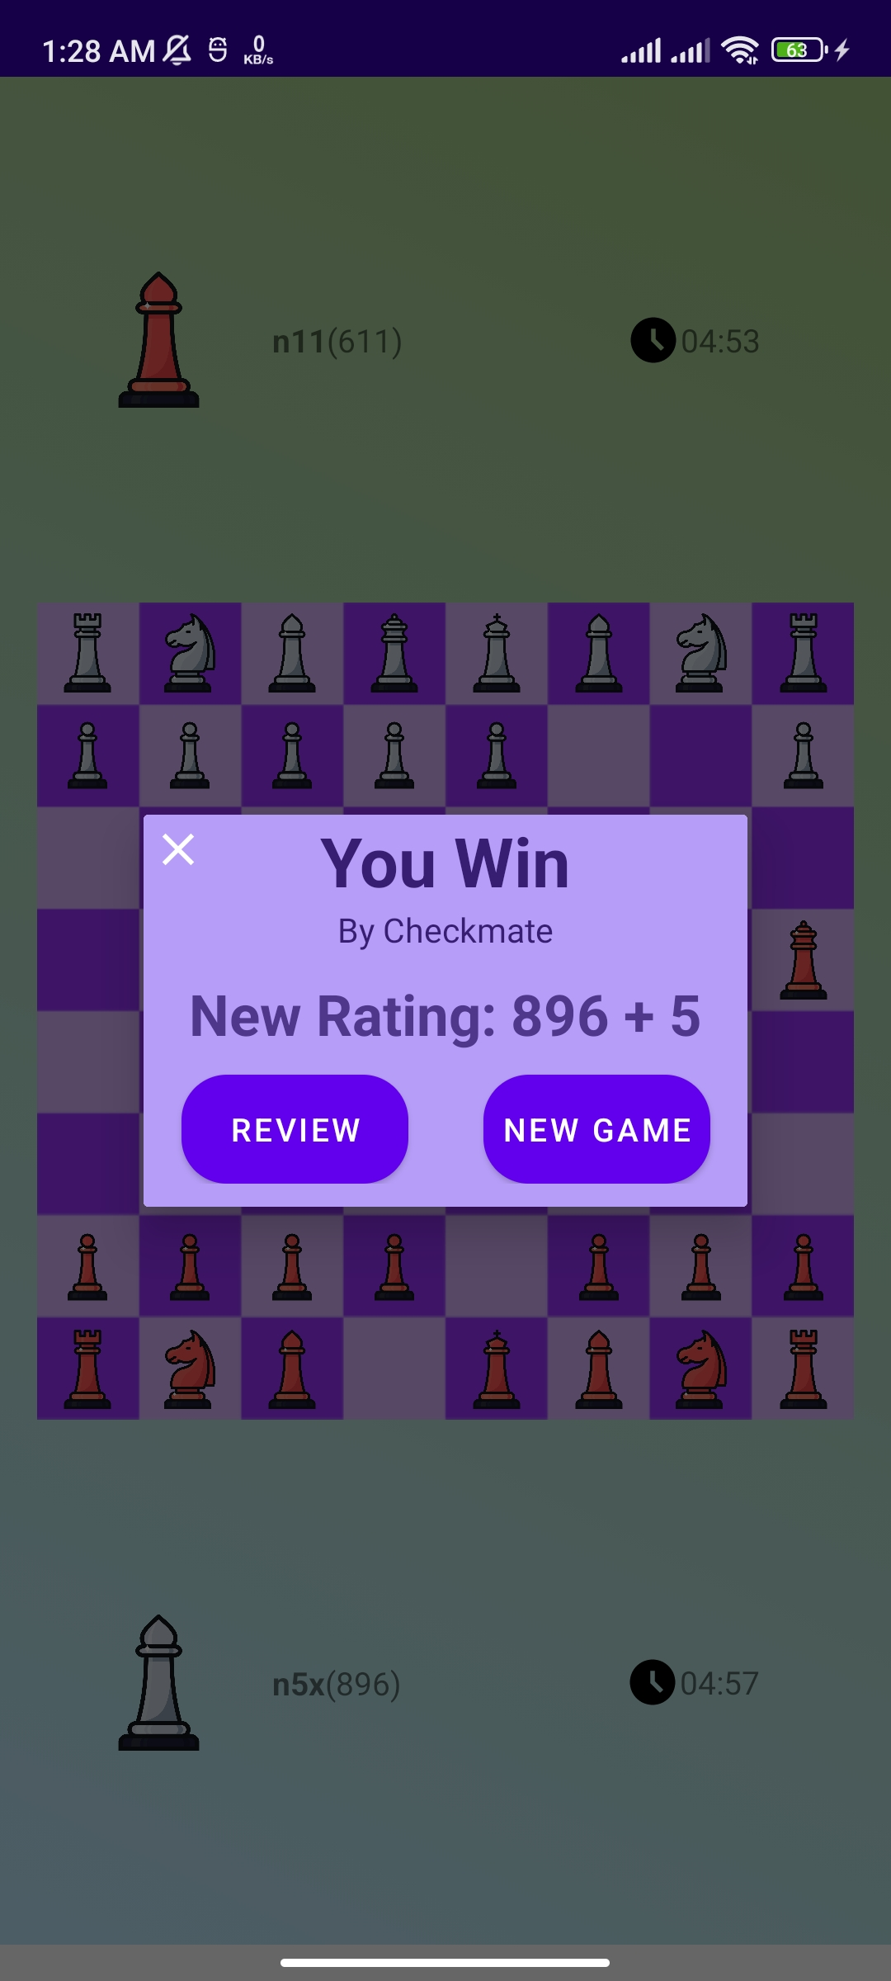
Game: finished
Result – won or lost
Rating – new rating after the match
Review game – review the game
New game – start a new game

Slide 10
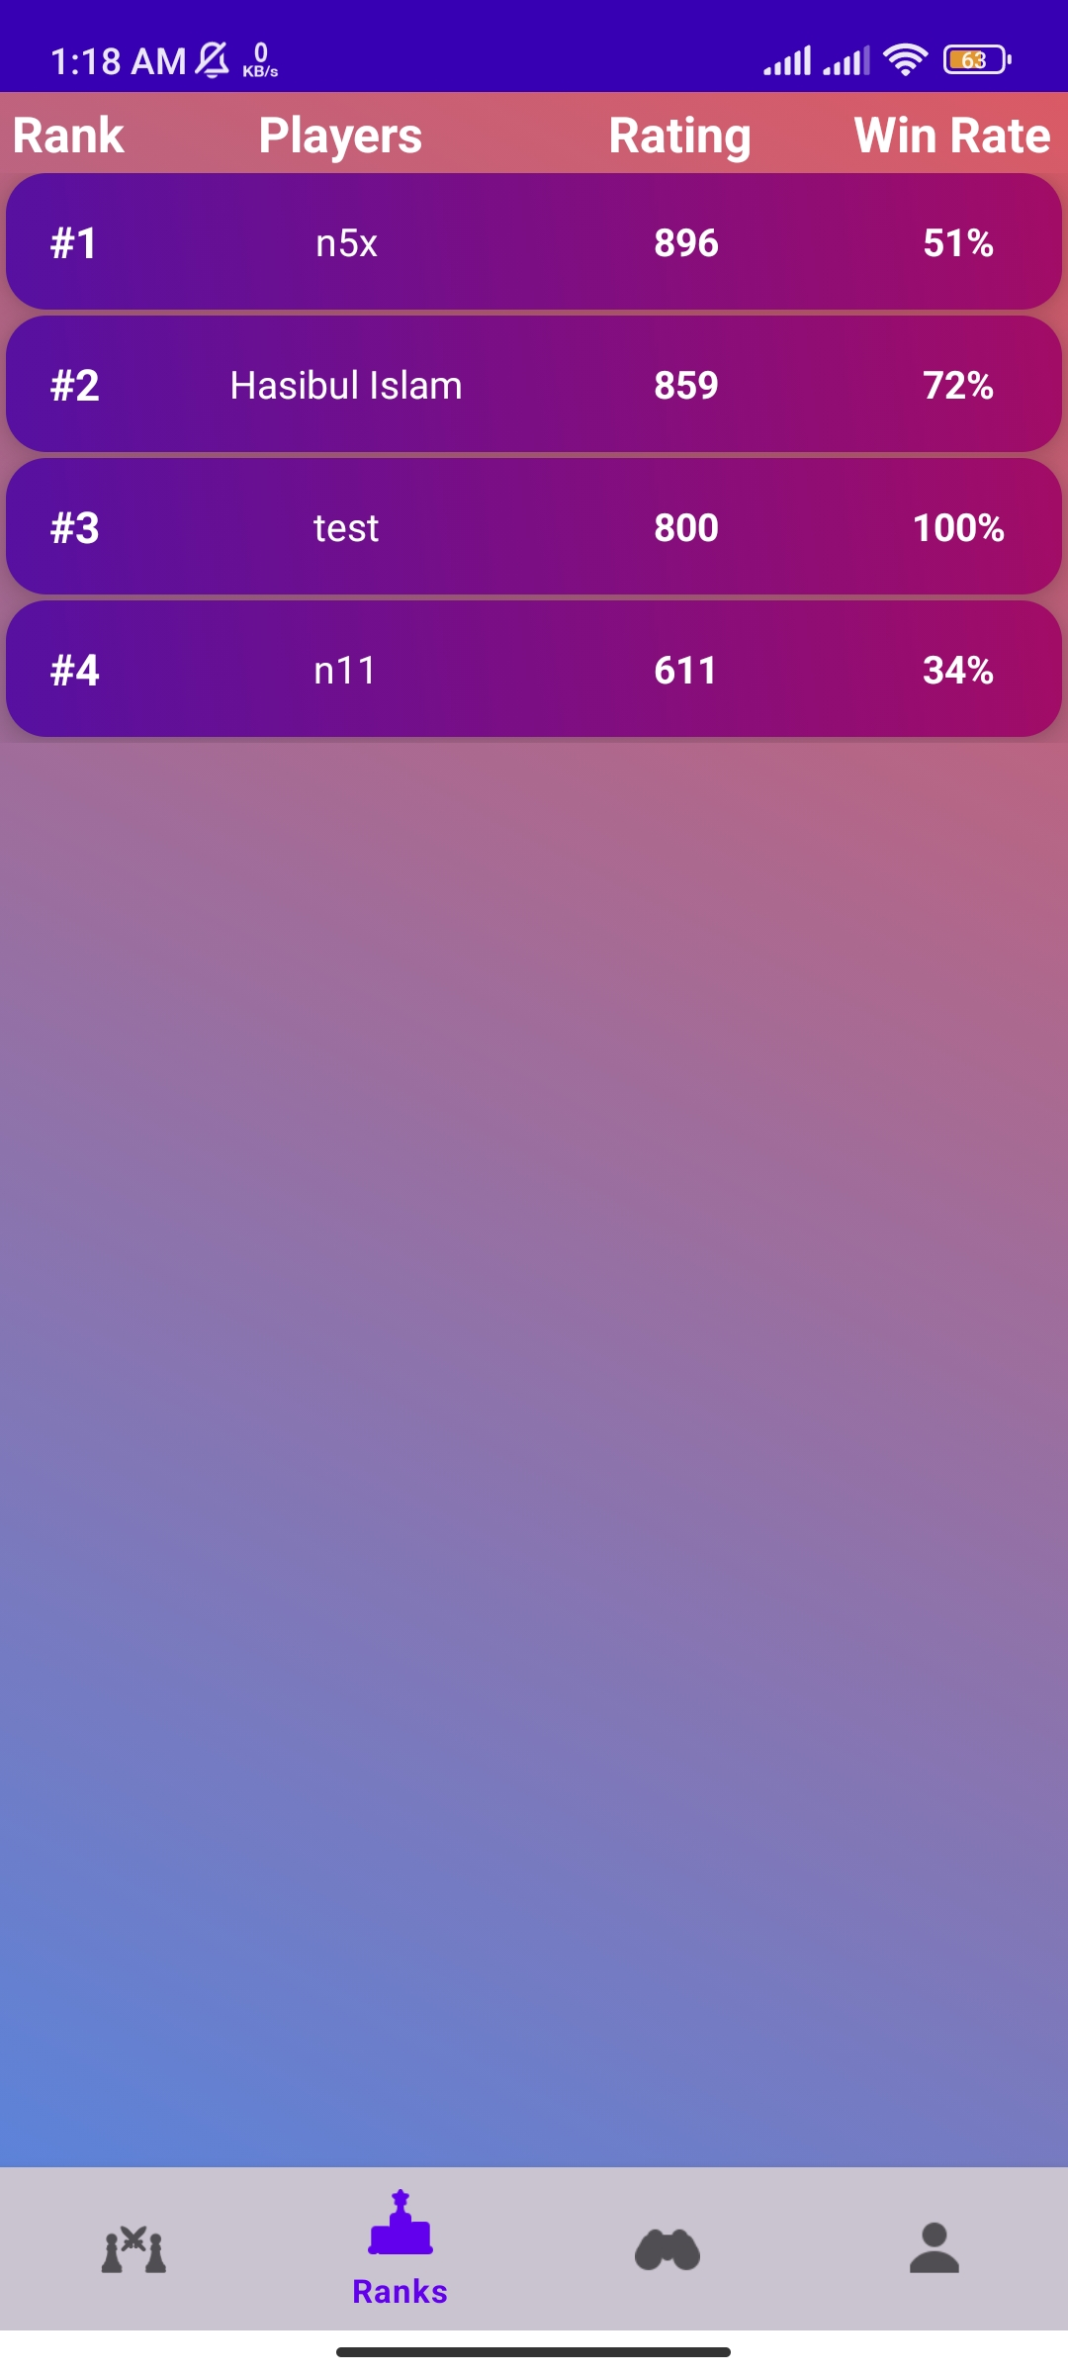
Ranks: Main Page
Rank – position of a player in the world
Player Name – player username
Rating – estimate the strength of a player
Win Rate – the ratio between games won and total games played
Players profile can be watched by clicking on the player card

Slide 11
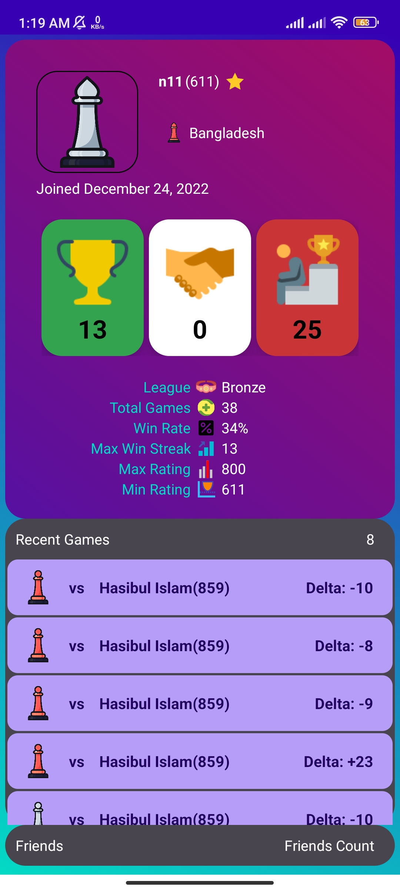
Player/friend profile
Player Information – username, rating, win, lose, draw
Recently played games – can be watched
Friends – the friends of that user
Add as friend

Slide 12
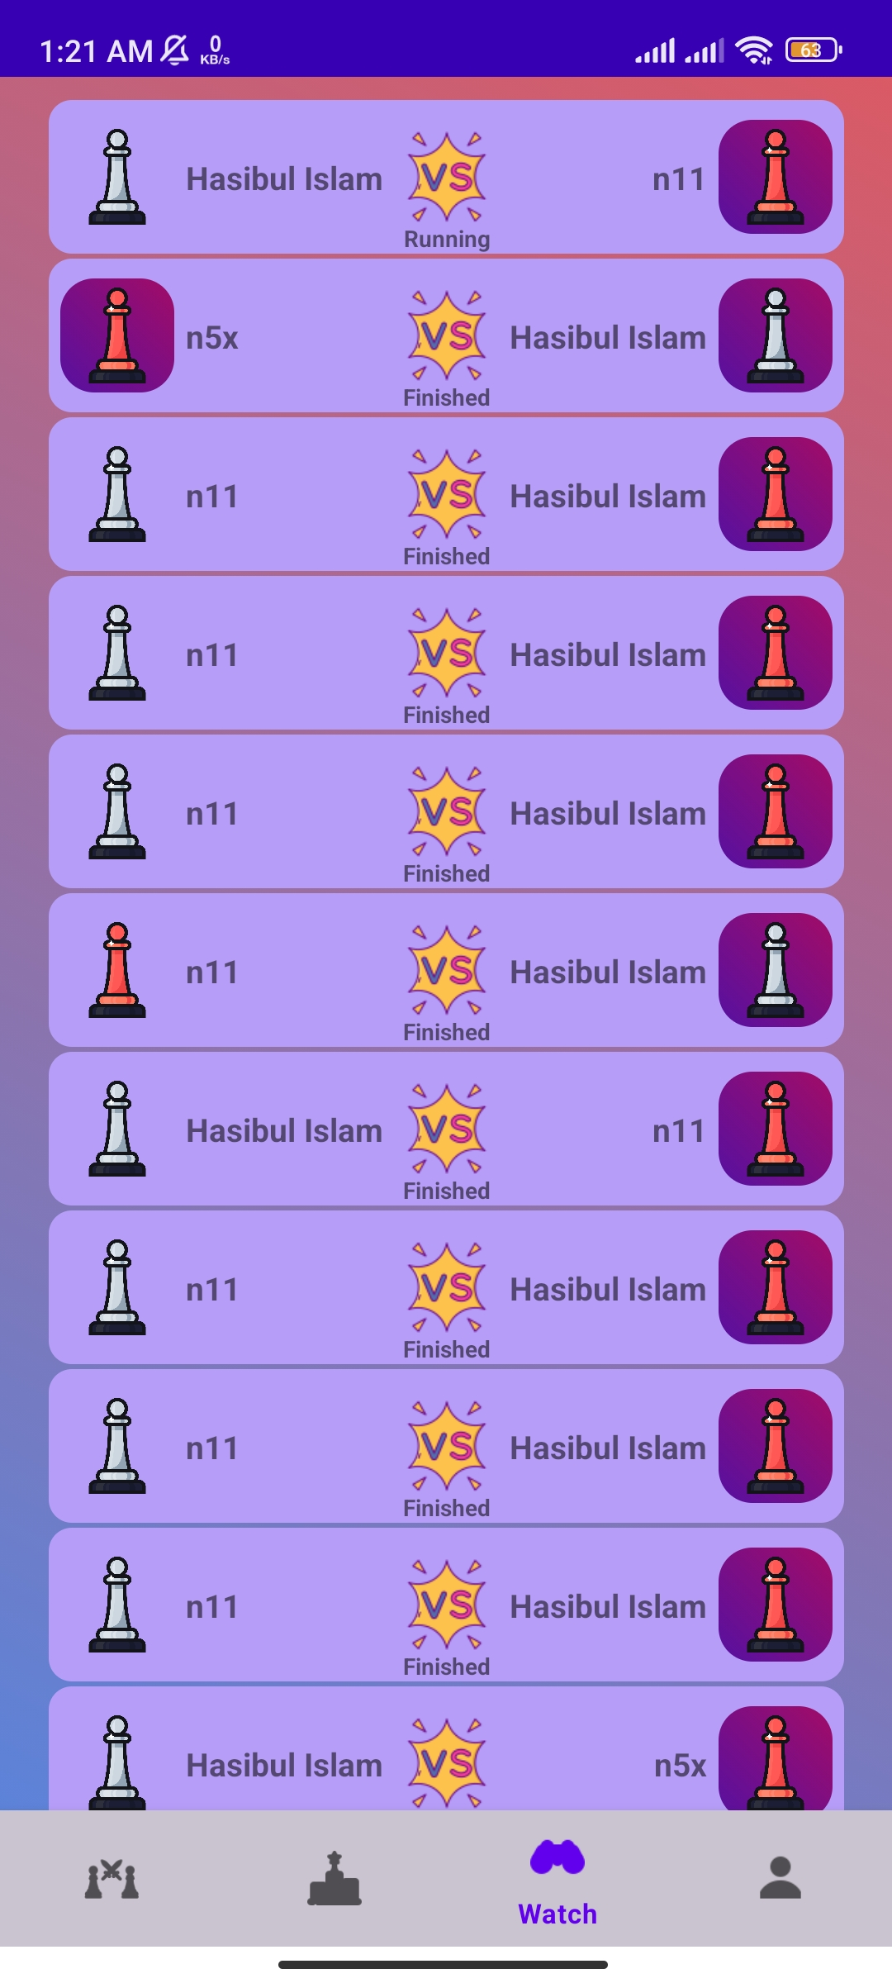
Watch
A list of all played games that can be watched
Player1 vs Player2
Running – games currently played by some players
Finished – games that have been finished
– winner has a background of dark purple

Slide 13
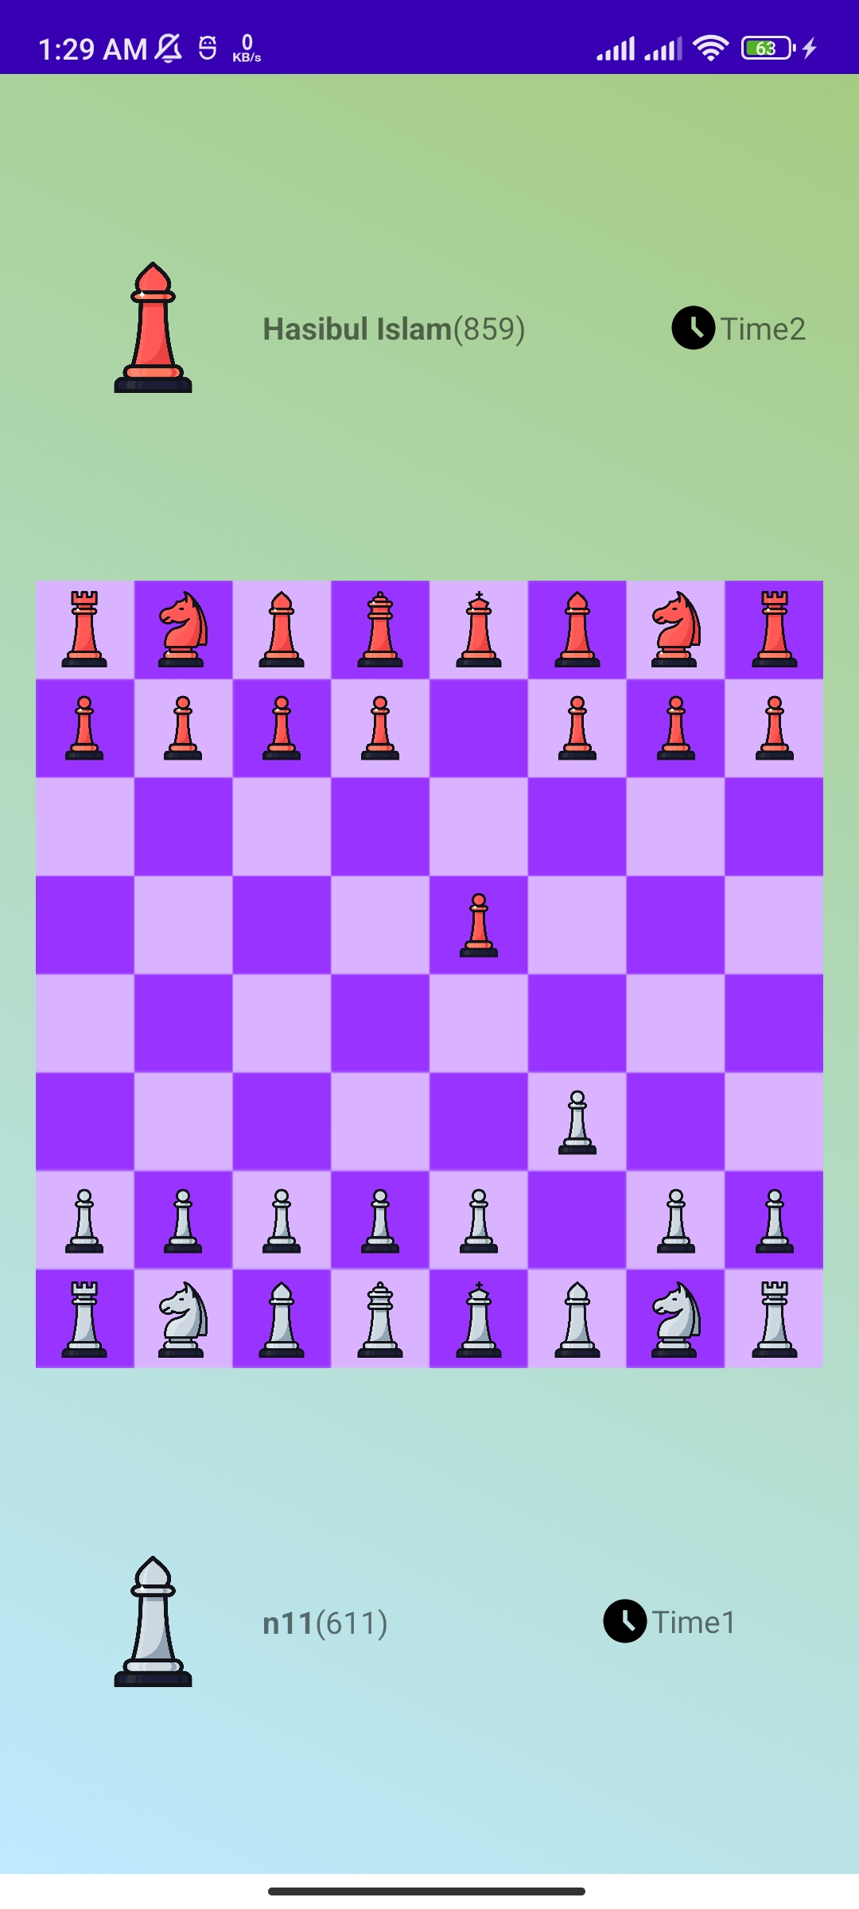
Watch game : running
Player1
Username
Rating
Player2
Username
Rating
Board – shows the currently running game moves

Slide 14
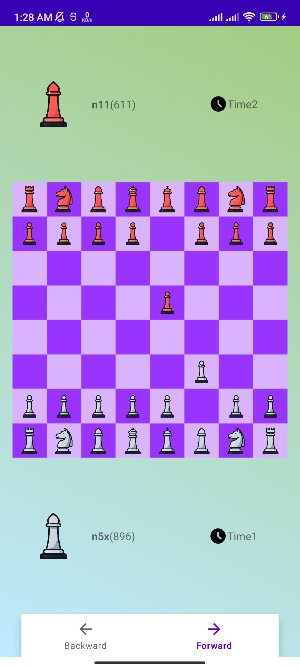
Watch game : finished
Player1
Username, Rating
Player2
Username, Rating
Board – shows the currently running game moves
Forward – performs the next move played in the game
Backward – reverse the move performed

Slide 15
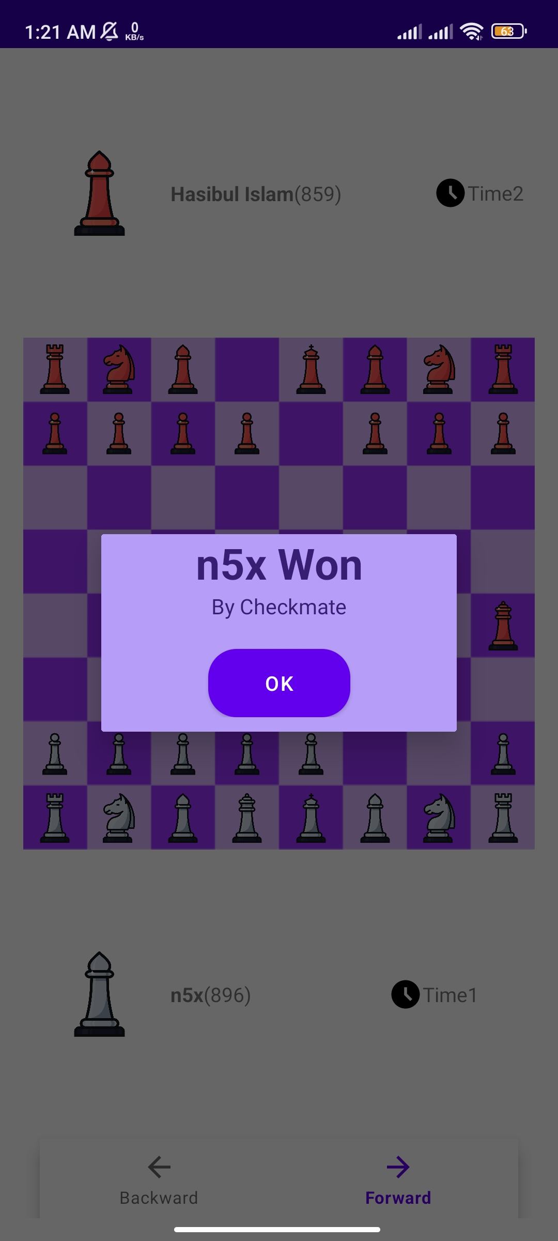
Watch game
Shows the result of the game
Winner name

Slide 16
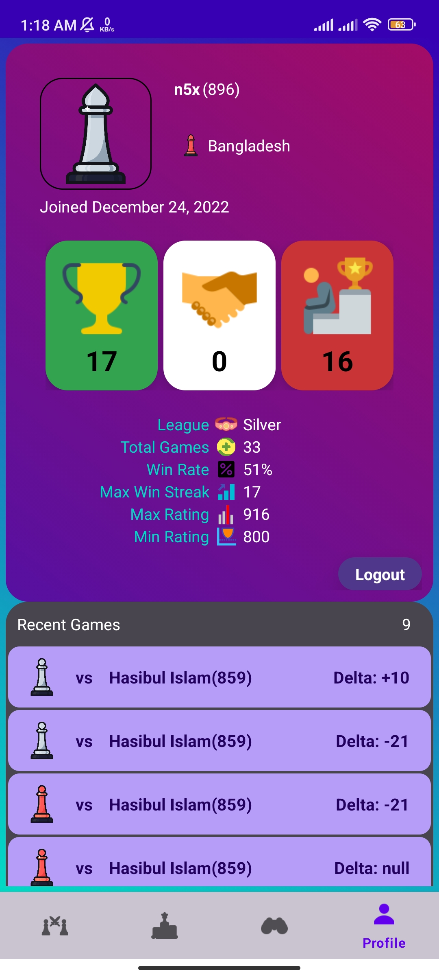
Profile
Player Information
Username, Rating, Country, Join Date
Win, Draw, Lose Count
League, Total Games, Win Rate, Win Streak, Max and Min Rating
Recent Games
Friends

Slide 17
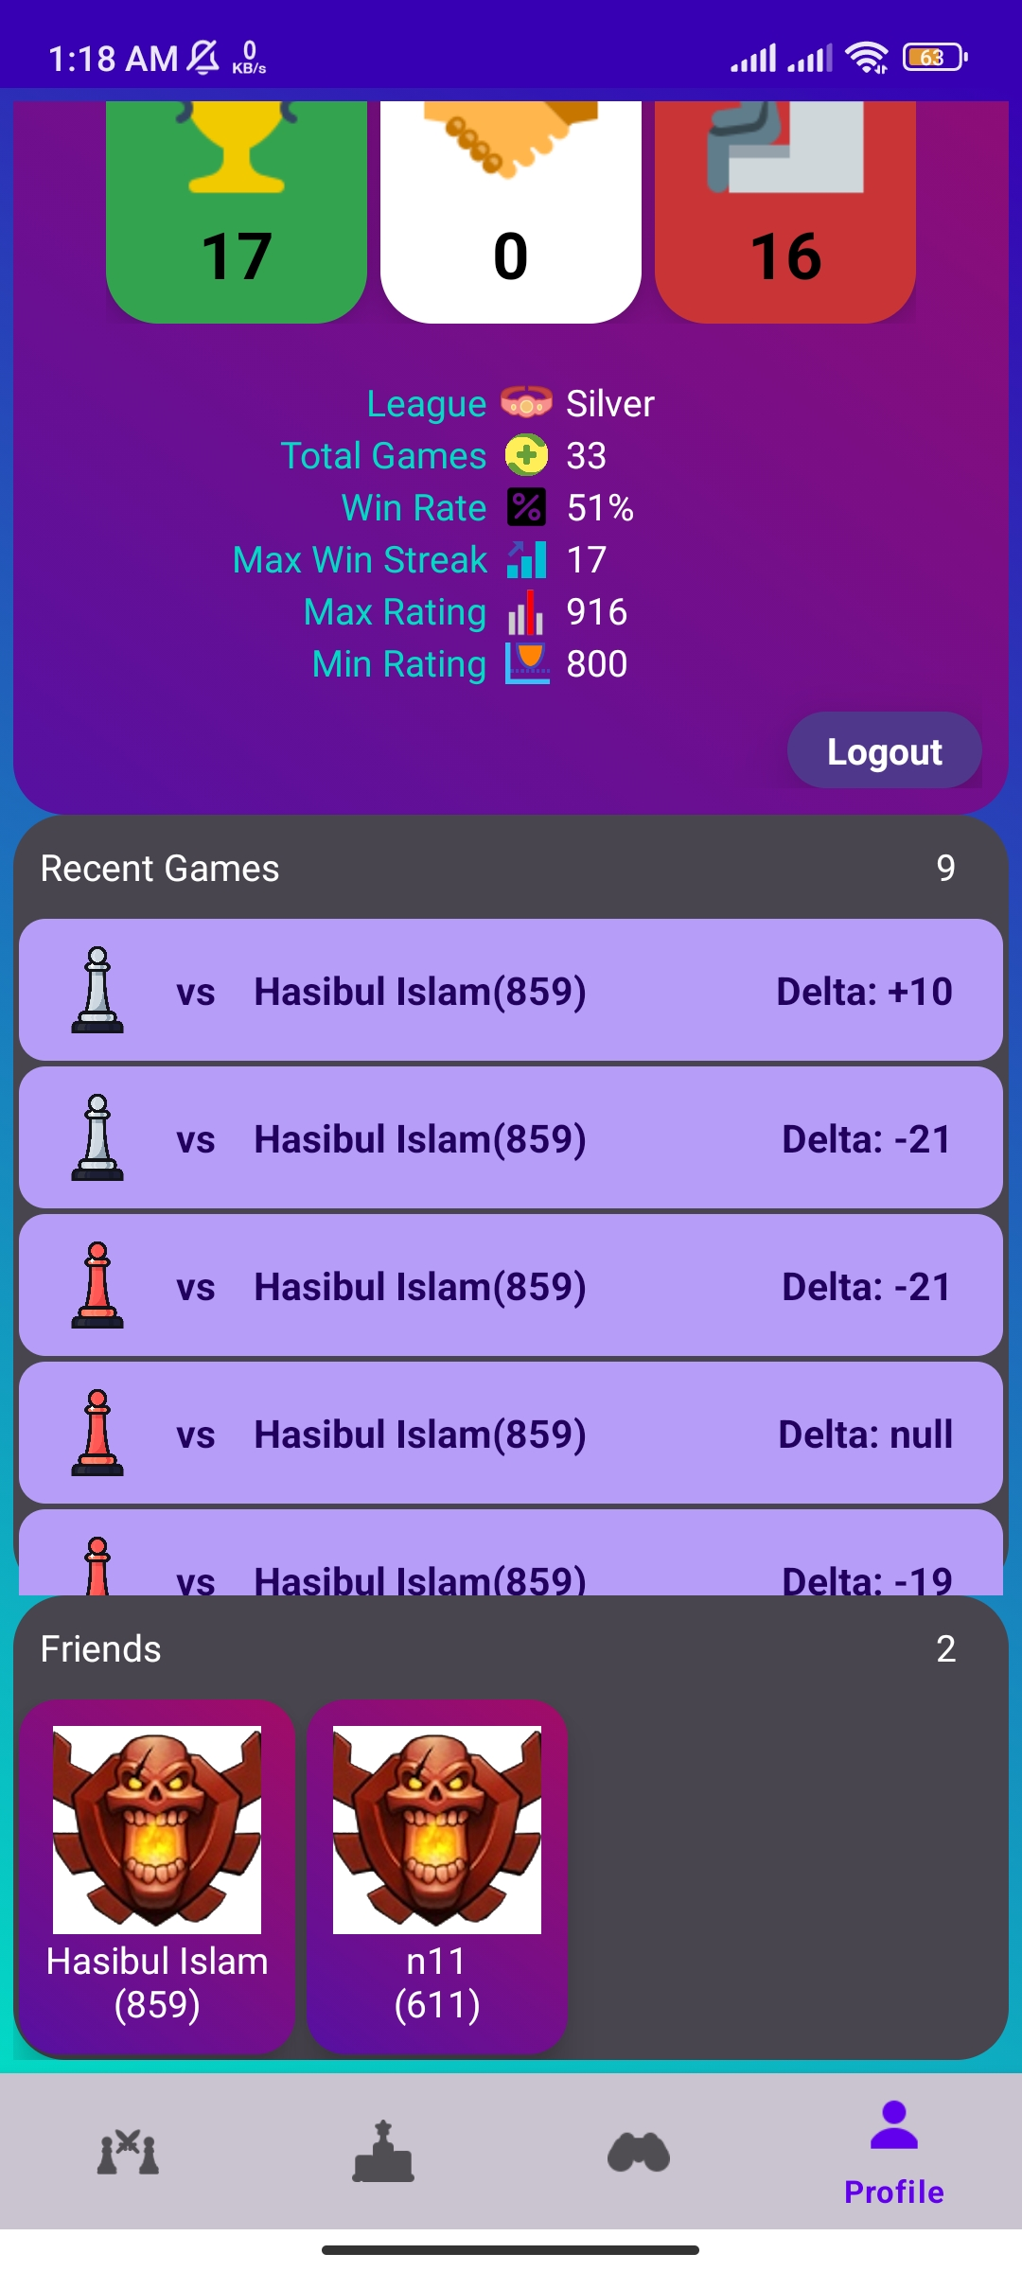
Profile : recent games
Recent games – shows all games played by the user
Player Color
Opponent Username with Rating
Update in rating

Slide 18
Profile : Friends
Friends – show the list of friends
Username
Rating
Can be navigated to the friends profile

Slide 19
Game: Authentication
Start
Have an account
Create new account
Login to enter in the game
Username
Email Address
Password
Game

Slide 20
Game: Different Activity
Game
Select Activity
Play Game
Leaderboard
Watch Games
Profile

Slide 21
Game: Game
Play Game
Start Game
Select option
Join Game
Choose Color
Select a game from the list
White
Black
Game
Result

Slide 22
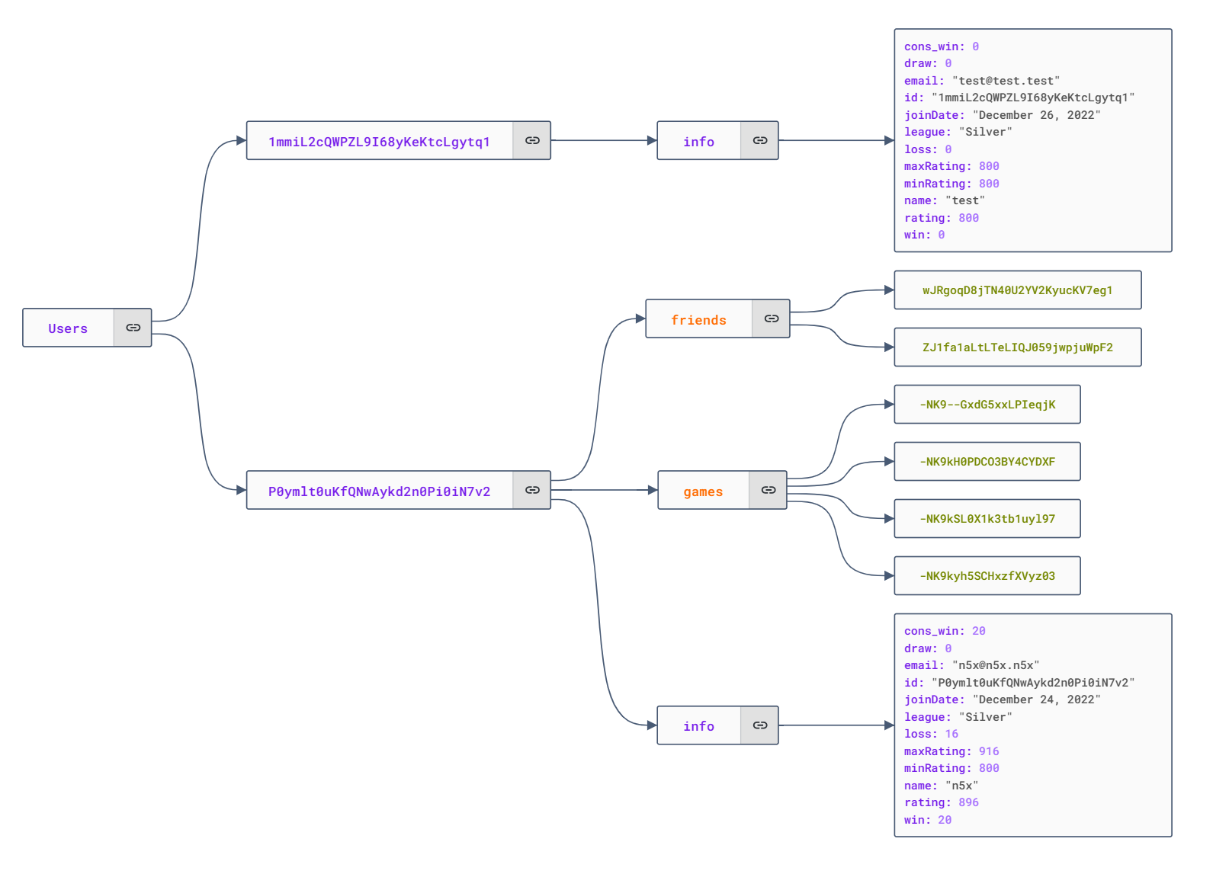
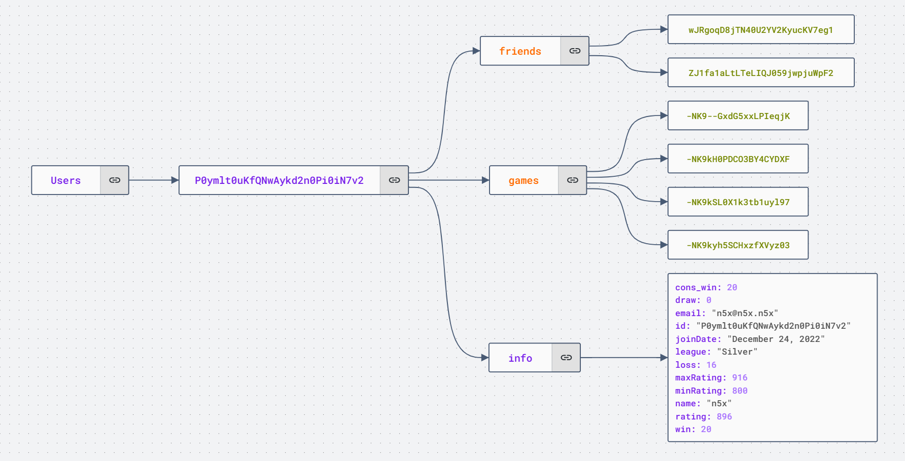
Database: Users

Slide 23
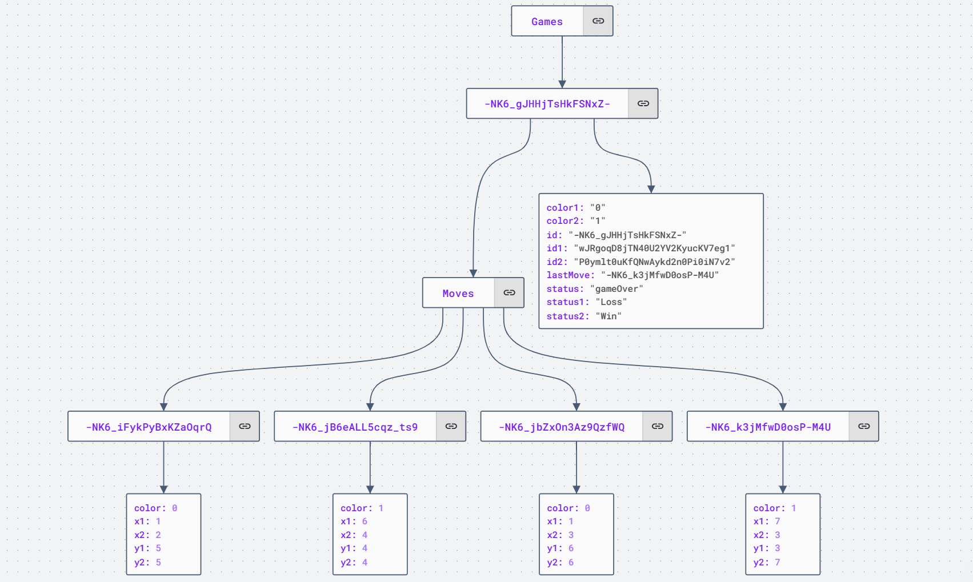
Database: Games

Slide 24
Future Plan
Add offline multiplayer mode
Add play vs computer mode
Add challenge to friends option
Add chat option in running game

Slide 25
Thank You

